Slide 1

CHOCO DE LUXE SALES PERFORMANCE ANALYSIS:
Detailed review of sales performance and growth strategies
by
Chinelo Akinleye

Slide 2
Overview of Choco De Luxe’s Market Position
Analysis covers:
  Location Sales Performance
  Channel Effectiveness
  Salesperson Productivity
  Product Profitability
  Organic vs Non-Organic Demand
  Profit Margin Overview
Goal: Identify growth opportunities and optimize profitability through data-driven insights.
Notes:
Understanding the company’s background, product offerings, target markets, and competitive environment is crucial for evaluating its current standing and future opportunities.

Slide 3

Company Background and Product Portfolio
Premium Chocolate Brand
  Choco De Luxe is recognized as a premium chocolate brand known for quality and luxury.
Diverse Product Portfolio
  The brand offers a wide range of products from classic chocolates to innovative confectionery creations.
Strong Market Presence
  A diverse product range helps strengthen the brand identity and expands market reach effectively.
Notes:
---
Choco De Luxe is a premium chocolate brand with a diverse product portfolio ranging from classic chocolates to innovative confectionery. This foundation supports its brand identity and market reach.
Image source: Microsoft 365 content library

Slide 4
Target Market and Customer Segmentation
Luxury Consumers
Luxury consumers seek premium and exclusive chocolate products with high-quality packaging and unique flavors.
Gift Buyers
Gift buyers look for chocolate products suitable for presents, often preferring attractive boxes and special editions.
Everyday Chocolate Lovers
Everyday chocolate lovers prefer accessible, delicious chocolates for regular consumption and indulgence.
Notes:
---
Choco De Luxe targets various customer segments, including luxury consumers, gift buyers, and everyday chocolate lovers. Identifying these segments helps tailor marketing and product strategies effectively.
Image source: Microsoft 365 content library

Slide 5
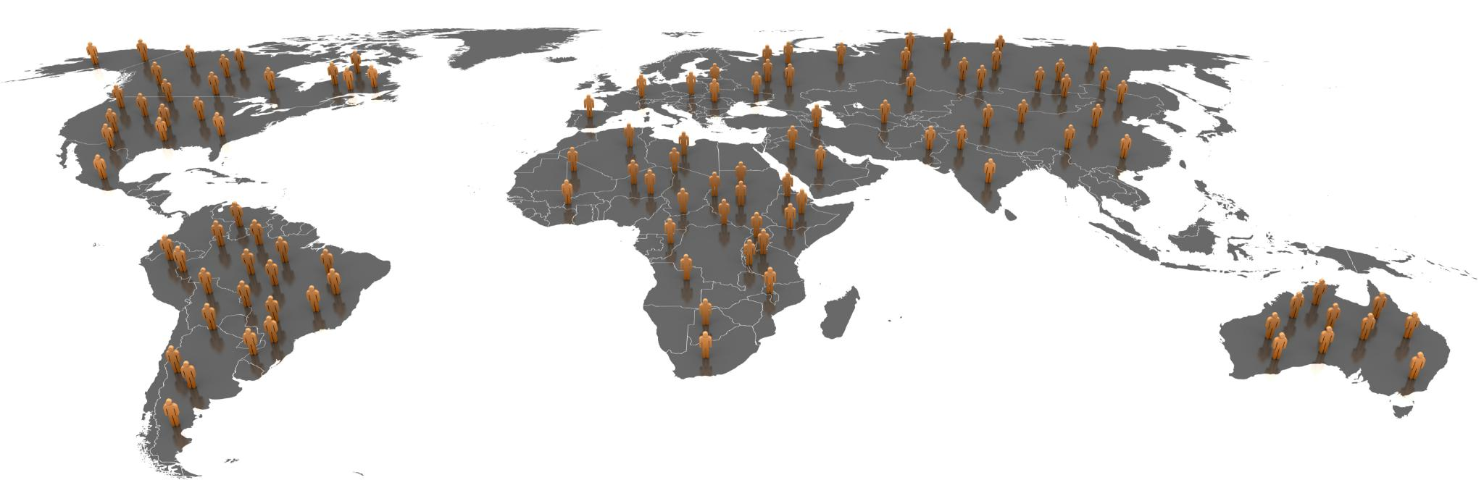
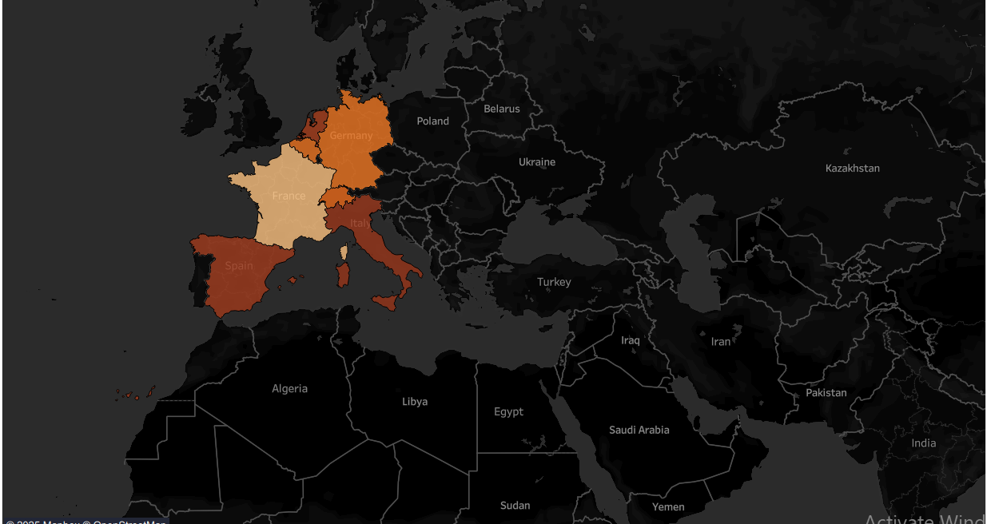
Regional Sales Breakdown and Patterns
Key Points:
Spain, France, and Germany lead in the highest success rate of product delivery.
Italy, Spain, and the Netherlands lead in both revenue and profit.
High delivery success (>95%) reflects operational excellence.
Underperforming regions show low sales and weaker logistics efficiency.
– Recommendations
Key Actions:
Focus marketing and logistics support in top-performing regions.
Improve delivery infrastructure in low-performing areas.
Notes:
---
Sales performance varies by region due to demographic and economic factors. Understanding these patterns supports targeted regional strategies to maximize revenue.
Image source: Microsoft 365 content library

Slide 6
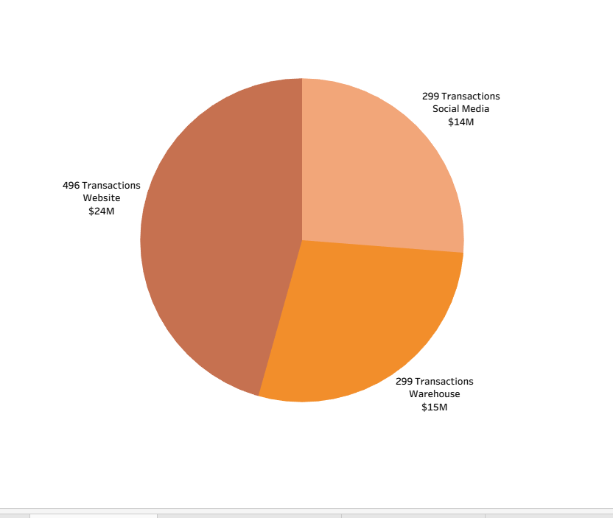
CHANNEL EFFECTIVENESS

Slide 7

CHANNEL EFFECTIVENESS
Key Points:
Website channel contributes the highest revenue and profit.
Warehouse channel drives large sales but at lower margins.
Social Media performs well for engagement but with fewer transactions.
– Recommendations
-Expand digital marketing for high-margin channels.
-Optimize warehouse operations for cost efficiency.
-Increase seasonal campaigns on social platforms to boost sales.
Notes:
---
A detailed review of gross and net profit margins identifies profitability levels, cost influences, and margin trends critical for financial decision-making.
Image source: Microsoft 365 content library

Slide 8
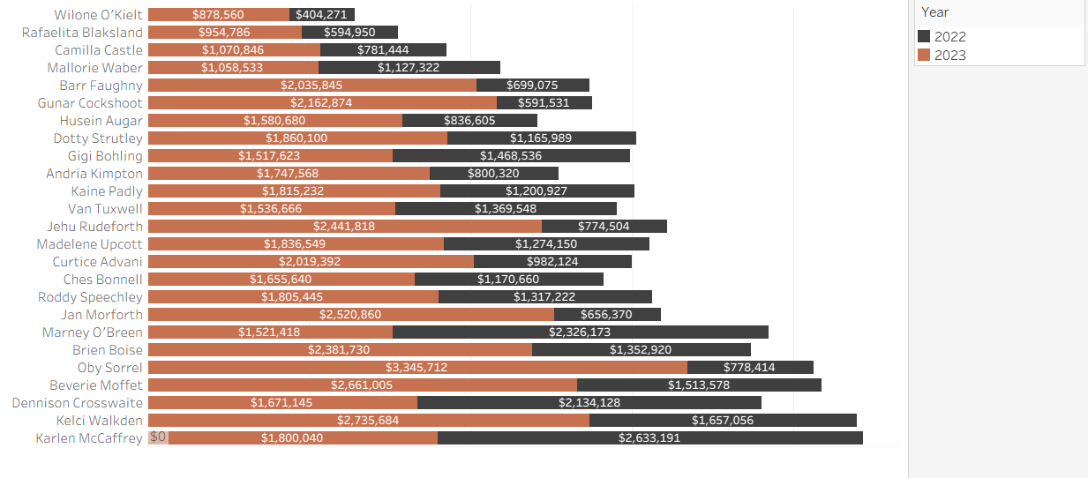
SALESPERSON PRODUCTIVITY

Slide 9

SALESPERSON PRODUCTIVITY
Key Points:
Several salespeople exceeded the $100,000 target.
Top performers achieve over 250% attainment.
Underperformers (<50%) need training or territory realignment.
--Recommendations
Reward and retain high achievers with incentive programs.
Provide targeted coaching for underperformers.
Realign territories and adjust performance targets.
Notes:
---
Understanding how costs are distributed across production, marketing, distribution, and overhead helps identify areas for cost control and efficiency improvements.
Image source: Microsoft 365 content library

Slide 10
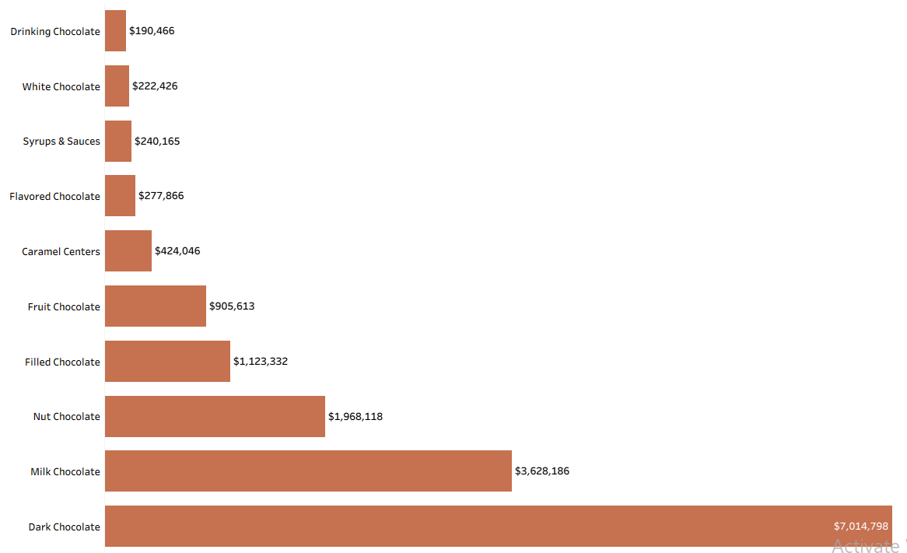
PRODUCT PROFITABILITY
Key Points:
The profit margin remains consistent at 46% across all categories.
Dark, Milk, and Nut Chocolates dominate in profit margin.
Consistency shows strong pricing and cost management.
- Recommendations
Prioritize high-performing product lines in production and marketing.
Explore premium pricing in top-selling categories.
Monitor input costs to maintain profit margins.
Notes:
---
Assessing ROI and other financial metrics such as liquidity and solvency ratios offers a comprehensive view of Choco De Luxe’s financial stability and investment attractiveness.
Image source: Microsoft 365 content library

Slide 11
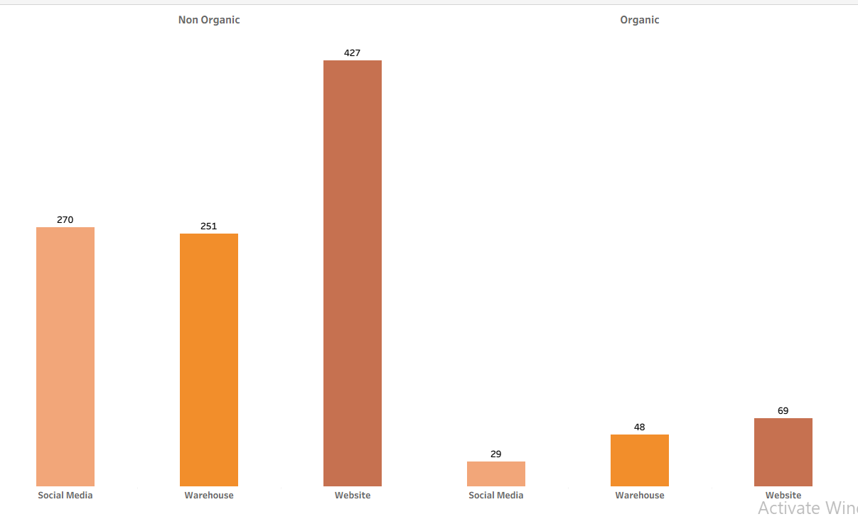
Organic vs Non‑Organic Demand — by Channel
Notes:
Based on the analysis, strategic recommendations are proposed to enhance sales, optimize costs, and foster innovation, ensuring sustainable growth.

Slide 12

ORGANIC VS NON-ORGANIC DEMAND
Key Points:
Organic products account for a smaller revenue share but have strong loyalty.
Non‑Organic dominates: Website 427 vs 69 (Organic), Warehouse 251 vs 48, Social 270 vs 29.
Online and Social Media drive most organic product sales.
Organic demand exists but is a premium niche (~15-20% of units).
Treat organic as a differentiation play with storytelling, provenance, and limited editions at higher margins.
Recommendations
Increase digital ad campaigns for organic products.
Expand organic SKUs in high-performing categories.
Bundle organic and non-organic items to boost cross-sales.
Notes:
---
Proposed strategies include expanding distribution channels, targeted marketing campaigns, and leveraging seasonal promotions to boost sales and capture greater market share.
Image source: Microsoft 365 content library

Slide 13
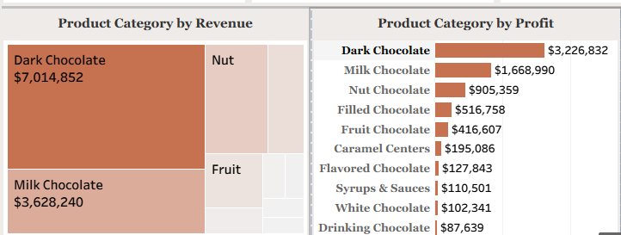
Revenue & Profit Drivers — What’s working
Notes:
---
Introducing new product lines and flavors, as well as adopting consumer trends like healthy and sustainable ingredients, can drive innovation and attract new customers.
Image source: Microsoft 365 content library

Slide 14
Revenue & Profit Drivers — What’s working
Profitability is strong overall (≈46% margin), indicating premium positioning and disciplined cost control.
High delivery success (95.61%) reduces refunds/claims and supports customer satisfaction and repeat buying.
Concentration in top product lines provides scale advantages for sourcing, packaging, and marketing
Dark Chocolate ≈ $3.23M profit (leader) and $7.01M revenue
Milk Chocolate ≈ $1.67M profit and $3.63M revenue
Nut Chocolate ≈ $0.91M profit and $1.97M revenue
Filled ≈ $0.52M; Fruit ≈ $0.42M; Caramel Centers ≈ $0.20M.
Flavored, Syrups & Sauces, White, and Drinking form the long tail (<$0.28M each).
Recommendation:
These products drive the majority of profit contribution (70%+). They define the brand identity
Their stability funds innovation in other product lines.
Protect leaders: maintain availability, premium packaging, and gift bundles.

Slide 15
RECOMMENDATIONS
Product Strategy:
Always keep inventory healthy--stock-outs in hero lines(Dark / Milk / Nut Chocolate) directly weaken revenue & market perception.
Premium Packaging: Since these are flagship products, premium packaging enhances brand equity and allows pricing at a premium.
Grow Mid-Tier Categories (Filled / Fruit / Caramel) by curating sampler packs, mini bundles combining 3–6 smaller variants and encourage customers to explore new flavors → future upsell.
Limited seasonal flavors (Valentine, Easter, Christmas, Autumn-themed assortments) create urgency and trial.
Re-position Low performing products like (White & Drinking Chocolate, Syrups & Sauces. Sell as a premium niche rather than mainstream (e.g., for gifting or specialty consumers)
Reformulate the quality to improve taste, size, sweetness profile, cocoa %, or packaging

Slide 16
Pricing and Bundling
Introduce Tiered Bundles (Classic, Premium, Family) - to Increase Average order value & Margin
A/B test anchor pricing and decoy options for hero bundles.
Channel Strategy
Website-UX / Search / Filters: Improve navigation so users can quickly find chocolate type (dark/milk/nut), price range, bundle, or occasion
Personalized Cross-Sell-When a user adds a Milk Chocolate bar, recommend Nut or Premium bundle as an upgrade
Warehouse: sell curated gift packs to companies, improve retailer partnerships, and volume‑based pricing tiers.
Social: Use timed releases with influencers to create hype + urgency without permanent discounting, use scarcity model; this protects margin while still driving strong traffic and brand buzz.
Market Strategy
Double down on Spain/France/Italy with geo‑targeted ads and retail activations.
Pilot uplift in Poland and selected Eastern EU cities; track incremental lift vs controls.
Localize messaging and seasonal SKUs to regional tastes/holidays.

Slide 17
Salespersons Enablement
Weekly leaderboard with attainment %, pipeline coverage, and win‑rate by segment.
Document playbooks for top bundles and cross‑sell; share in weekly huddles.
30‑60‑90 Day Plan
0–30: Website UX quick wins; define KPI dictionary; start regional scorecards.
31–60: Pilot 2 geo‑campaigns; introduce 3 bundles (Classic/Premium/Family).
61–90: Roll out attainment program; decide on long‑tail SKU actions from contribution data.
6–12 Month Roadmap
Scale B2B gifting/subscription partnerships.
Expand subscription program; refine pricing with elasticity tests.
Broaden organic premium storytelling; limited high‑margin editions online.

Slide 18

Choco de Luxe has strong margins and reliable delivery.
Prioritize website experience, hero SKU protection, mid‑tier growth, and geo/channel plays.
Execute the 30‑60‑90 plan and roadmap to compound profit and strengthen brand equity.

Slide 19
